Slide 1
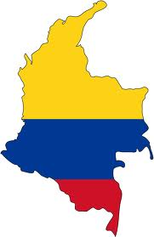
CBI in Colombia
Developing and promoting Colombian exports to European markets

Slide 2
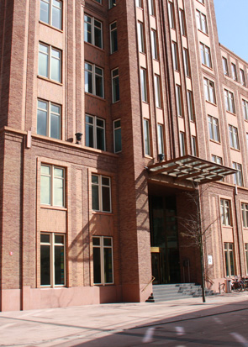
Facts and Figures
1971: CBI was established by the Ministry of Foreign Affairs of the Netherlands
1998: Agency
60 employees
Worldwide network of 250 experts
Annual budget of 25 mln EUR
Active worldwide in some 40 countries
Mission: To contribute to sustainable economic development in developing countries through the expansion of exports from these countries
The Hague
Notes:
Appropriately based in Rotterdam, Europe’s largest harbour and the bustling gateway to the Continent’s vast surface-based logistics network, the CBI has 60 employees at its Head Office and a powerful global network of around 250 experts, representing more than 40 nationalities. The CBI was established by the Ministry of Foreign Affairs of the Netherlands and became an agency in 1998.

Slide 3
Vision
CBI is THE expert in export development and export promotion from developing countries
Focus
Stakeholders
Integrated approach
Core Competences
CSR
Sustainable strengthening of the competitive capacity of SME-exporters and producers in developing countries with a primary focus on European markets
Powerful and large worldwide network
For SMEs, BSOs and governmental authorities
Advice, counselling and knowledge management
Embracing the principles of corporate social responsibility
Notes:
We have a solid network of international stakeholders.
The CBI focuses on sustainable enhancement of the competitiveness of SME-exporters and producers in developing countries with a primary focus on Europe. While temporary measures may be insufficient, the CBI makes sure the exporters and producers are able to run their own business before phasing out their training and guidance.
The CBI knows what steps to take to ensure a good network which is strong en sustainable. Because we specialise in three main target groups who are linked together we are able to optimise our services for every target group and make sure they can do business with one another in an efficient and optimal way.
The core competences of the CBI exist of, in the first place advice, followed by guidance and knowledge management.
Our guiding principle is social responsibility in business operations

Slide 4
CBI Programmes consist of
ECP Modules
BSOD Modules
MI Modules
HRD Modules
Export Coaching For SMEs
Increasing the competitive capacity of SMEs on European market
Institutional Development For BSOs
Improved sustainable service provision to exporters
Market Intelligence for SME en BSOs
www.cbi.eu/marketinfo
Human Resources Development for staff of SME en BSOs
export knowledge and export skills
Notes:
ECP Modules: Five modules designed to help exporters compete on European markets: Business audit and action plan,
Business development, Export capacity building, Certification, Market access Europe / regional
BSOD Modules: Aimed to assist BSO to assess competencies and instruments, devise strategy and set up operational business plans, determine the feasibility of predetermined targets, and how to meet them in practice: Diagnosis and intervention design,
BSO Export Intelligence, Export development and export promotion
MI Modules: Aimed at companies and organisations wishing to identify market opportunities, keep up with the latest European trends and/or need insight into EU legal requirements.
HRD Modules: modules aimed at creating knowledge, developing skills and attitude coaching for SMEs and BSOs staff members

Slide 5
Export Coaching modules
Business Audit and action plan
Business Audit and action plan
Assessment SME on competence for European market entry by means of an export audit
Plan of action
Certification
Providing expertise regarding the proces of certification
Possibility of co-financing
Certification
Business development
Market entry Regional
Realisation of skills and experience of their marketing concerning both the regional and European markets
Realising a sufficient amount of relevant business contacts
Taking part in trade fairs, conferences, roadshows and/or B2B
Business development
Coaching the SME to further professionalisation of their business operations
Market entry Regional
Export
Capacity
Building
Market entry EU
Export
Capacity
Building
Coaching SME to meet European market demands
Exploring European markets
Developing an export strategy
Market entry EU
Notes:
Five modules designed to help exporters compete on European markets:
Business audit and action plan Assessing companies as regards their readiness to enter the European market by means of export audit and setting up an action plan;
Business development Supporting companies with the further professionalisation of their operational management;
Export Capacity building Supporting companies in complying with the requirements of European markets, exploring European markets and developing an export strategy;
Certification Providing expertise in processes relating to certification and possibilities for co-financing;
Market entry (regional and Europe) Gaining skills and experience in marketing in regional market(s) and/or European markets; acquiring sufficient relevant contacts via participation in trade fairs, conferences, roadshows and/or B2B.

Slide 6
Colombian exports to Europe (2010)
Product Group | mln EUR | % of total exports to Europe | Primary product
 | 2.611 | 52%
 | 1.076 | 21%
 | 402 | 8%
 | 231 | 5%
 | 114 | 2%
 |  | 88%

Slide 7
Colombian exports to Europe (2010)
Product Group | mln EUR | % of total exports to Europe | Primary product
Mineral fuels, oils, distillation products, etc | 2.611 | 52% | Coal
Edible fruit & nuts | 1.076 | 21% | Bananas
Coffee and spices | 402 | 8% | Coffee
Iron and steel | 231 | 5% | Ferro-nickel
Live trees, plants, bulbs, roots, cut flowers etc | 114 | 2% | Flowers
 |  | 88%

Slide 8
Colombian exports to EU (2010)

Slide 9
Colombian exports to Europe (2010)

Slide 10
Colombian exports to Europe (2010)
 | Country | Colombian Exports (mln EUR) | Primary products
1 | Germany | 933 | 61% minerals, 24% fruit, 7% coffee
2 | Netherlands | 784 | 80% minerals, 8% iron & steel
3 | United Kingdom | 721 | 61% minerals, 17% fruit, 7% coffee
4 | Belgium | 592 | 81% fruit, 8% minerals
5 | Italy | 522 | 38% minerals, 20% iron & steel, 14% fruit
6 | Spain | 474 | 48% minerals, 13% iron & steel, 9% coffee
7 | France | 404 | 64% minerals, 8% coffee
 | Other European countries | 400
 | Europe Total | 5.044

Slide 11
Colombian imports from Europe (2010)

Slide 12
Colombian imports from Europe (2010)
 | Country | Colombian Imports (mln EUR)
1 | Germany | 1.248 | Machinery, aircrafts, vehicles, pharmaceuticals, electronics
2 | France | 890 | Machinery, electronics
3 | Italy | 482 | Machinery, pharmaceuticals
4 | Spain | 378 | Machinery, iron & steel
5 | Switzerland | 310 | Machinery, pharmaceuticals, medical apparatus, organic chemicals
6 | United Kingdom | 304 | Machinery, pharmaceuticals
7 | Netherlands | 241 | Aircrafts, pharmaceuticals, electronics, machinery, fertilizers
8 | Belgium | 122 | Pharmaceuticals, machinery, plastics
 | Other European countries | 621
 | TOTAL | 4.596

Slide 13
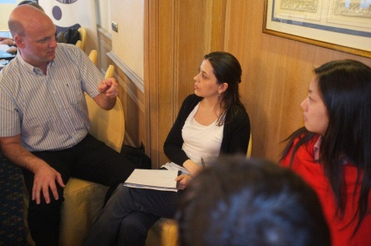
CBI in Colombia
Supporting +/- 70 Colombian SME exporters through CBI’s Export Coaching Programmes
Providing training to many more Colombian SMEs on European export-related issues like Trade Fair participation, website promotion, and Corporate Social Responsibility (CSR)
An ambitious institutional development programme with Proexport (focus on new uniform market intelligence and service delivery methodology, Knowledge Management tools, and upgraded Market Intelligence and Export Promotion skills and competencies of its staff)
Developing a new Tourism promotion programme (2012-2016)
Developing a new national export development & promotion programme (2013-2017)

Slide 14
Most problematic factors for Colombian exporters
According to World Economic Forum’s Global Enabling Trade Report 2012

Slide 15
CBI’s Export Coaching Programmes in Colombia
Sector | Number of Colombian SMEs
Tourism | 15
Outerwear | 11
Natural Ingredients for Food & Cosmetics | 11
ITO Services | 7
Fresh Fruit & Vegetables | 6
Medical Devices & Lab Equipment | 4
Sector | Number of Colombian SMEs
Personal Protective Equipment | 3
Office & School Supplies | 3
Home Textiles | 3
Automotive Parts | 3
Subcontracting | 3
Pipe & Process Equipment | 3
Paints & Coatings | 2

Slide 16
Tourism Coaching Programme
15 companies (mostly tour operators, but also a wellness centre, and a group of boutique hotels in Cartagena)
Offering roundtrips (Bogota - Coffee Triangle – Cartagena), adventure trips, deluxe products, and ‘new’ areas of Bucaramanga and Medellin
Working to increase (1) demand from Europe through web portal, tourism fair concept, FAM/press trips, PR campaign, etc., (2) amount, diversity and quality of regional tourism products, and knowledge and skills of tour operators
Targeting UK, Germany, France, Spain, Netherlands
Main fairs: World Travel Market (London), ITB (Berlin), TopResa (Paris), Vakantiebeurs (Utrecht)
Main challenges: (lack of) communication, strategic planning
Strengths: changing image of Colombia, strong Government/Proexport promotion efforts

Slide 17
Outerwear & Fashion Sportswear Coaching Programme
11 Colombian SMEs
Mostly well–established Colombian brands for men’s women’s and children’s wear (Mundo Natura, Color Siete, Creytex, Hermeco, Zarzamora, etc.), 50-150/200 staff, from Bucaramanga, Cali, Medellin
Working on collections / concepts to compete with European brands
Targeting Germany, Benelux, UK, Italy
Fairs: Who’s next (Paris), ModeFabriek (NL), Bubble (UK), buyers’ mission to ColombiaModa, agent showrooms in EU
Challenges: Finding European distributors / agents for relatively expensive clothing, Setting the right (European!) tone in marketing - adapt the promotion material to European tastes, Knowledge of fabrics, Language, Image of Colombia
Strengths: collaborative spirit amongst them, very CSR-minded, close to Europe culturally
Notes:
Mostly brands: unique compared to other CBI countries, eg Peru, Bolivia, Vietnam and Macedonia. In Bolivia and Peru mostly private label. Vietnam and Macedonia mostly CMT.
Color Siete = men’s wear
Creytext = children’s wear
Expensive because: everything needs to be imported from other countries – no typically Colombian materials, such as Peru (pima cotton), or Bolivia (alpaca)
European taste: natural, don’t overdo it,

Slide 19
Natural Food & Cosmetics Ingredients Coaching Programme
11 Colombian SMEs
Food ingredients: fruit flakes, fruit pulps, instant quinoa, tea, herbs, stevia, cardamom
Cosmetic ingredients: essential oils (eg aloe vera), vegetable oils and plant extracts
Targeting Western European countries
Fairs: Sial (France), Anuga (Germany), Biofach (Germany), Incosmetics
Challenges: (lack of) professional marketing, strategic planning, knowledge about European market
Strengths: unique Colombian products, growing European demand for natural and healthy products
Notes:
Mostly brands: unique compared to other CBI countries, eg Peru, Bolivia, Vietnam and Macedonia. In Bolivia and Peru mostly private label. Vietnam and Macedonia mostly CMT.
Color Siete = men’s wear
Creytext = children’s wear
Expensive because: everything needs to be imported from other countries – no typically Colombian materials, such as Peru (pima cotton), or Bolivia (alpaca)
European taste: natural, don’t overdo it,

Slide 20
ITO Services Coaching Programme
7 Colombian SMEs
Offering offshore software development services, HRM systems, enterprise administrative/management software, Oracle to Java migration tool, business process management systems, mobile and social application development
Technology segments: Java, Oracle, Microsoft and Open Source development platforms
Working on active and continuous promotion activities and formal quality certifications
Targeting the Government/public sector, HRM and recruitment sector, travel & tourism sector, and other sectors in Spain, UK, Germany, Netherlands
Main trade fairs: CEBIT + specialized trade events
Challenges: language, marketing approach (passive), low budget for export promotion

Slide 21
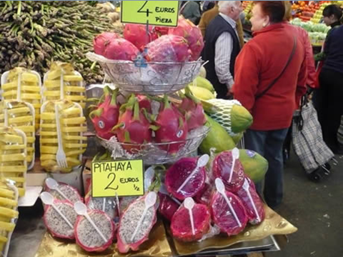
Fresh Fruit & Vegetables Coaching Programme
6 Colombian SMEs or producer associations
Offering avocado, herbs (thyme, rosemary), exotic fruits like pitahaya, tamarillo, granadilla, physalis (uchuva) , passion fruit (maracuya), lime, baby bananas
Main trade fair: Fruit Logistica (Berlin)
Working on establishing sustainable loyal relations between exporters and importers
Challenges: GlobalGAP Certification, informality in the sector, many unforeseen issues (weather, climate, low harvest, damage during transport), quality issues, European high standards (and not so high prices!)
Notes:
establishing sustainable relations between Colombian exporter and European importer is an issue: there is much informality in this sector; not much loyalty, many operators on the spot market, there is also a lot that can go wrong with perishables, during transport, and during cultivation (climatic conditions, etc) which often jeopardizes the relation between supplier and buyer

Slide 22
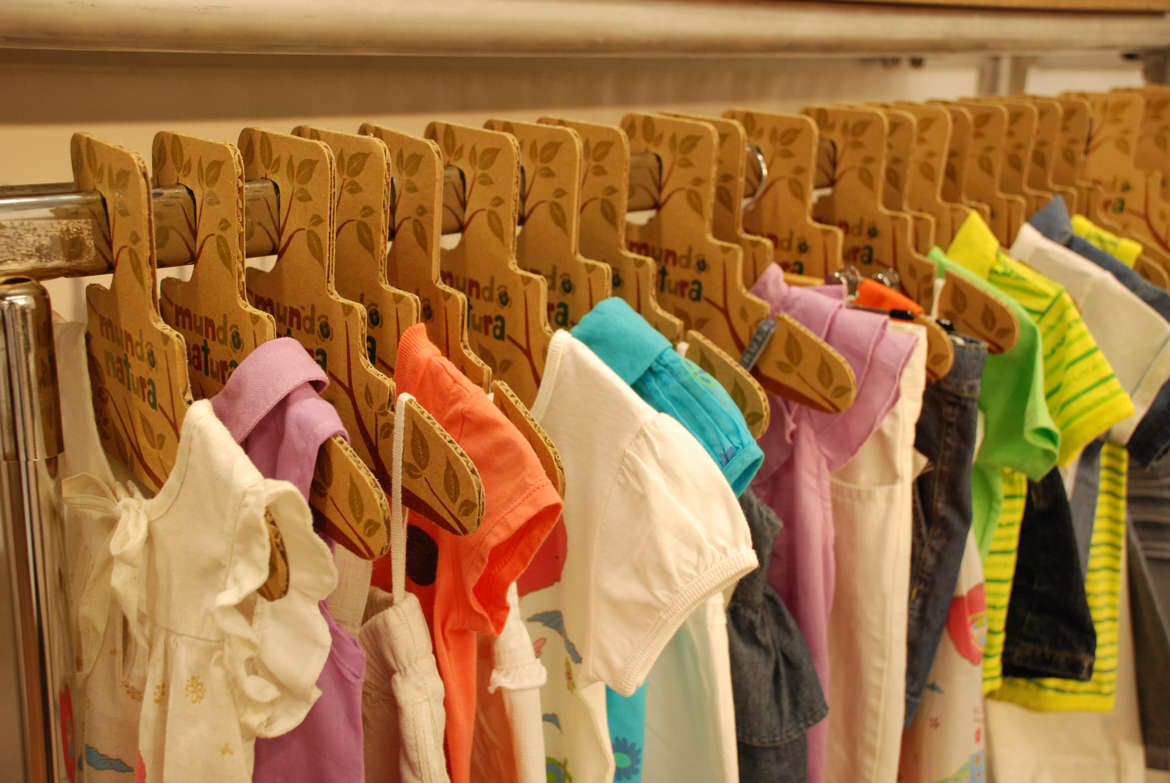
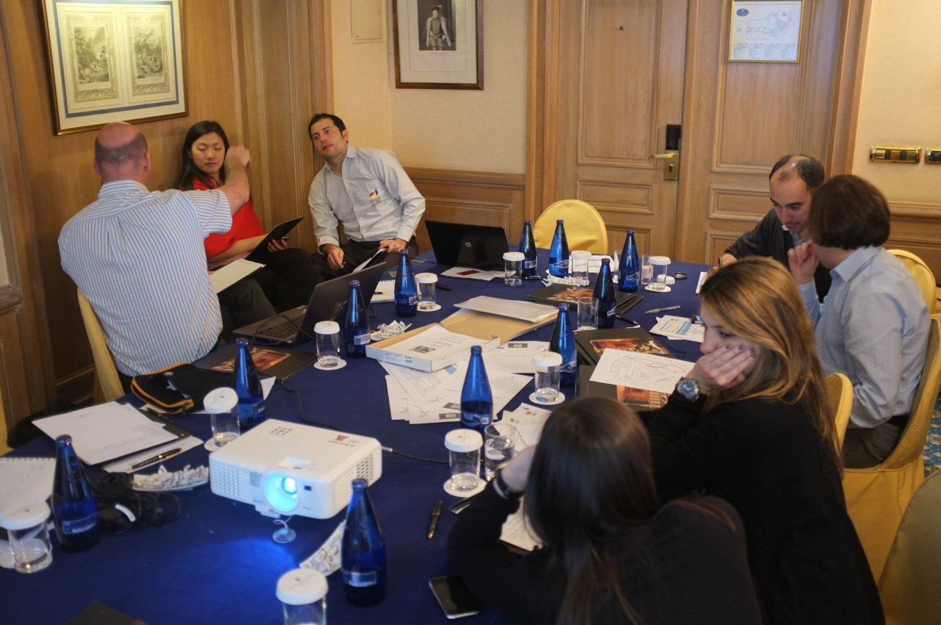
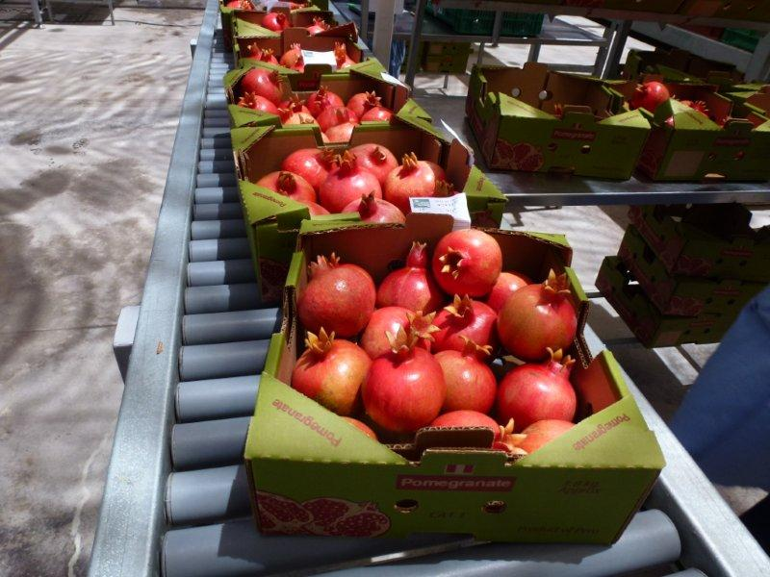
Thank you!
eplaisier@cbi.eu
www.cbi.eu/colombia

